Slide 1
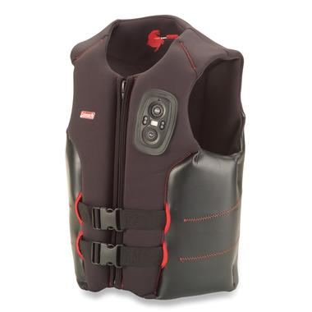

SMART LIFE JACKET
Group Members:
Harshita Bapna
Kritika Kumawat
Manali Jain
Mahendra Dangi

Slide 2
Components Used
Arduino uno board
GSM Module (SIM800/SIM900)
GPS Module
Pulse Sensor

Slide 3
Need
On any emergency situation like air crash or shipwreck, a life jacket plays the most crucial role in saving one’s life.
But the survivor may have to wait for very long for rescue as the rescuers don’t have the precise location of the victim. The victim may die during these hours.
Here our smart jacket comes handy. It is fitted with a GPS Module and pulse sensors which transmits the heart rate and GPS Coordinates to the concerned authority, say rescuers.
Using this, the rescue operation can be done very easily and in a matter of moments.

Slide 4
Features
This smart life jacket houses various sensors to track and transmit various parameters.
This jacket houses a pulse sensor that is used to track the Heart rate of the victim in BPM
A GPS module is also fitted in the jacket which acquires the GPS coordinates and transmits them
A GSM module is provided which transmits the data to the concerned authority through mobile phone over GSM network
All these modules are interfaced with an ARDUINO 101 board which fetches the data from sensors, analyze it and sends it.

Slide 5
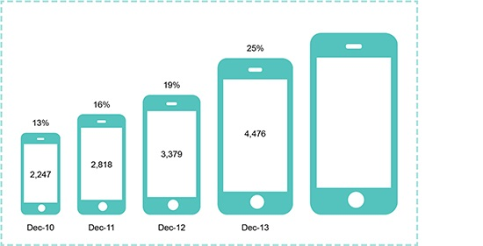

WORKING
GPS Module acquire and sends GPS coordinates
ARDUINO
GSM Module
Transmits the data over GSM to a mobile phone
Pulse sensor sends the heart rate in BPM
Data is collected over on an internet connected mobile

Slide 6
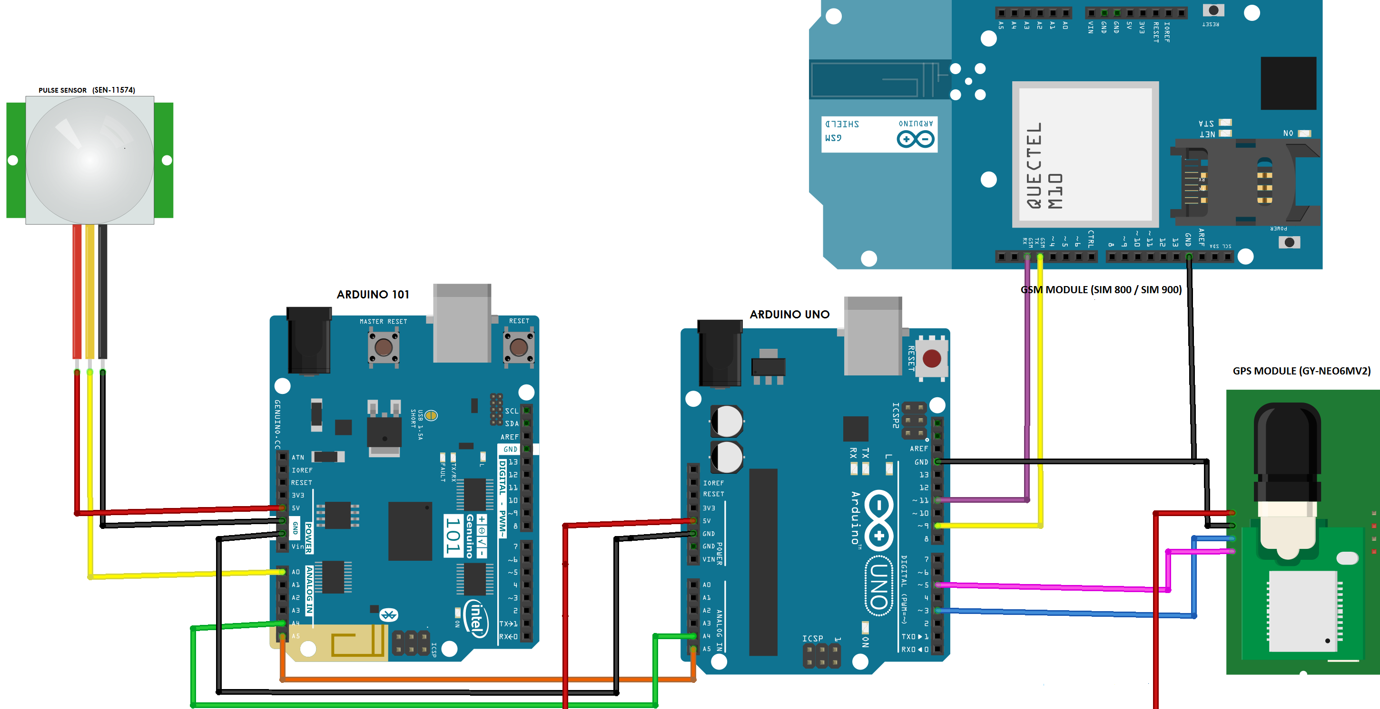
SCHEMATIC DIAGRAM:

Slide 7
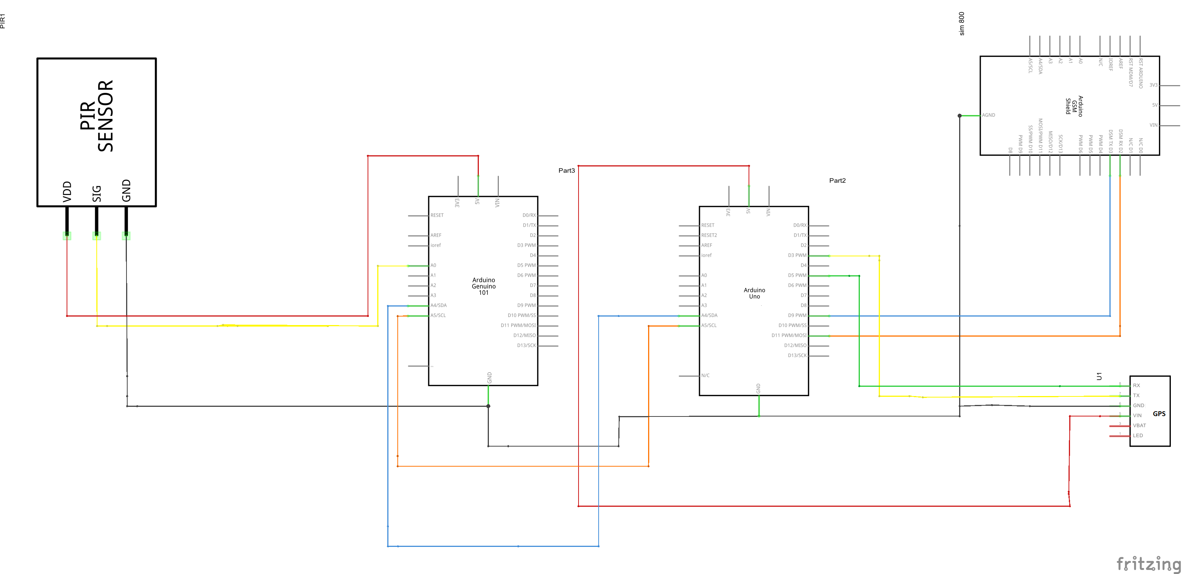

Slide 8
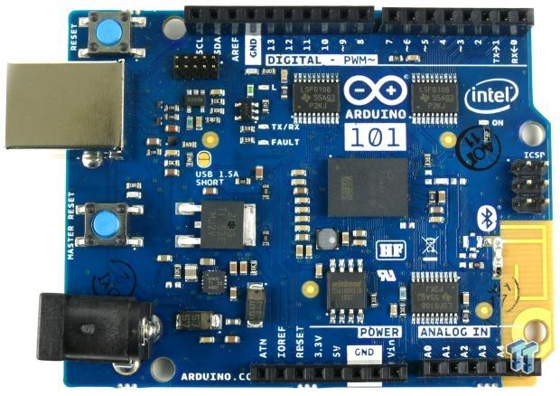
Arduino 101 Board
Development board by arduino.
Powered by a dual core Intel Curie Processor.
Processor clocked at 32MHz.
14 Digital outputs out of which, 4 can be used as PWM outputs.
It contains 6 Analog outputs, a USB connector for serial communication and sketch upload, a power jack, an ICSP header with SPI signals and I2C dedicated pins.
The board operating voltage and I/O is 3.3V but all pins are protected against 5V overvoltage.

Slide 9
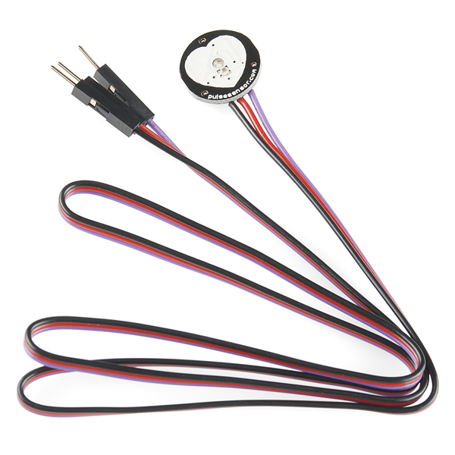
Pulse Sensor SEN-11574
Pulse sensor is used to Measure the pulse rate of the victim in Beats Per Minute (BPM).
This pulse rate is used to determine whether the victim is alive or dead.
And also used to detect that victim has put on the jacket or not.

Slide 10
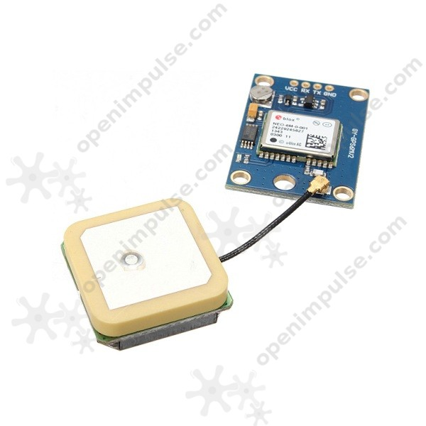
GPS MODULE GY-NEO6MV2 GPS Module
Used to acquire and send the GPS coordinates to the Arduino 101.
GPS Coordinates stored in form of latitude and longitude.
Can be interfaced with arduino easily.
Operable at 3.3V / 23mA

Slide 11
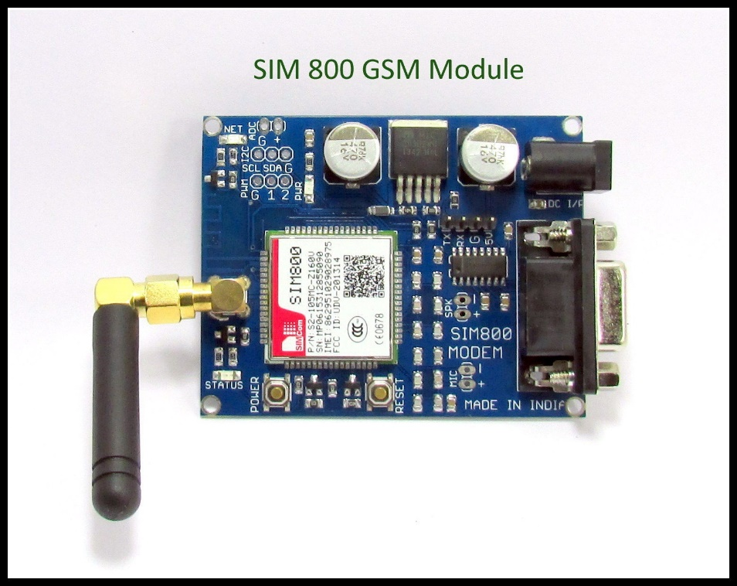
GSM Module SIM 800
GSM Module is used to send data to the mobile over GSM network.
SIM800 is a quad-band GSM/GPRS module
It works on frequencies GSM 850MHz, EGSM 900MHz, DCS 1800MHz and PCS 1900MHz
Power supply 3.4V ~ 4.4V.
Current consumption is as low as 1.2mA
One SIM card interface.

Slide 12
Purchase Link and Overall Hardware costing
ARDUINO UNO INR 482/-
Pulse sensor SEN11574 INR 415/-
GPS Module GY-NEO6MV2 INR 975/-
GSM Module (SIM800) INR 950/-
Estimated Cost INR 2,822/-

